Slide 1

Project Title – Airbnb Hotel Booking Analysis
Akshita R
INTERNSHIP_17546440516895be537820f

Slide 2

PROBLEM STATEMENT
The hospitality industry faces challenges in understanding customer booking behaviors, seasonal demand fluctuations, and high cancellation rates.
Airbnb booking data contains valuable patterns, but without proper analysis, these insights remain hidden.
The problem is to analyze this data to identify key trends, predict customer preferences, and uncover factors influencing booking and cancellations, enabling better decision-making for hosts and the tourism sector.

Slide 3
Project Description
The hospitality industry is rapidly evolving, and data plays a crucial role in understanding customer behavior and improving services.
This project focuses on analyzing Airbnb hotel booking data to extract meaningful insights into booking patterns, customer preferences, seasonal demand, and cancellation trends.
The dataset is explored through data preprocessing, cleaning, and Exploratory Data Analysis (EDA) to handle missing values, detect anomalies, and prepare it for meaningful analysis.
Visualizations are created to highlight key findings and patterns in customer demographics, booking lead times, length of stays, popular destinations, and seasonal demand fluctuations.
Availability is a crucial factor in Airbnb hotel booking analysis as it directly influences customer choices and demand patterns.
By examining availability data across different dates, regions, and seasons, the project highlights how listings vary during peak and off-peak periods.

Slide 4
Project Description
The analysis explores trends such as average room availability, seasonal fluctuations, city-wise differences, and the impact of booking lead times.
Host identity verification is an important aspect of Airbnb’s trust and safety framework.
In this project, the analysis examines how verified and unverified hosts differ in terms of booking frequency, customer trust, and cancellation rates.
Verified hosts generally contribute to higher customer confidence, leading to more bookings and better reviews, while unverified hosts may face lower engagement due to reliability concerns.
By exploring patterns in host verification, the project highlights its role in ensuring transparency, building trust between hosts and guests, and improving overall booking experiences on the platform.

Slide 5

WHO ARE THE END USERS?
Airbnb Hosts and Property Owners – to understand customer preferences, improve pricing strategies, and reduce cancellations.
Guests / Travelers – to identify the best time to book, avoid peak-demand issues, and find trusted verified hosts.
Hospitality Managers and Hotels – to analyze competition, seasonal demand, and improve occupancy planning.
Tourism Boards and Policymakers – to study travel trends and plan for peak/off-peak seasons in specific regions.
Data Analysts and Researchers – to explore booking behaviors, create predictive models, and support further studies in hospitality analytics.

Slide 6

Technology Used
Programming Language : Python for data manipulation and analysis.
Data Handling and Analysis : Pandas, Numpy for cleaning, preprocessing, and statistical operations.
Data Visualization : Matplotlib, Seaborn, Plotly for interactive and static charts.
Exploratory Data Analysis (EDA) : Python libraries to uncover trends, correlations and patterns.
Version Control : Git and GitHub for project collaboration.

Slide 7
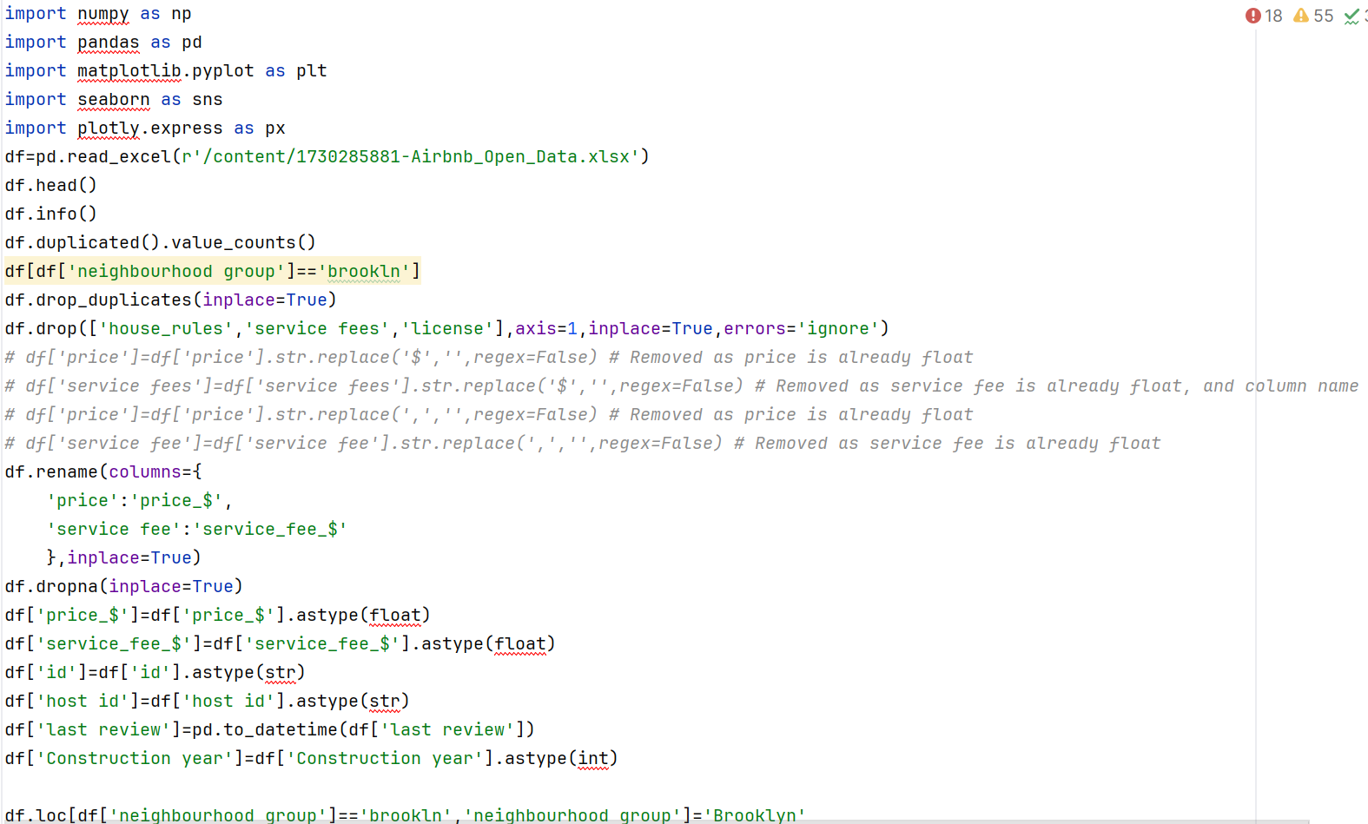
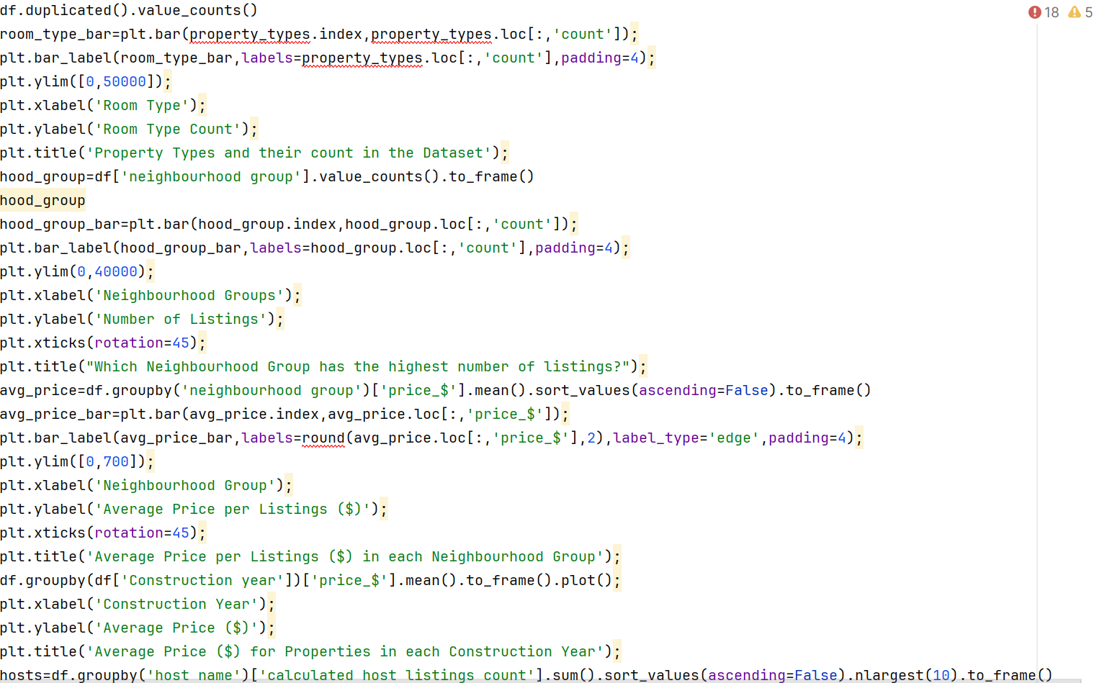
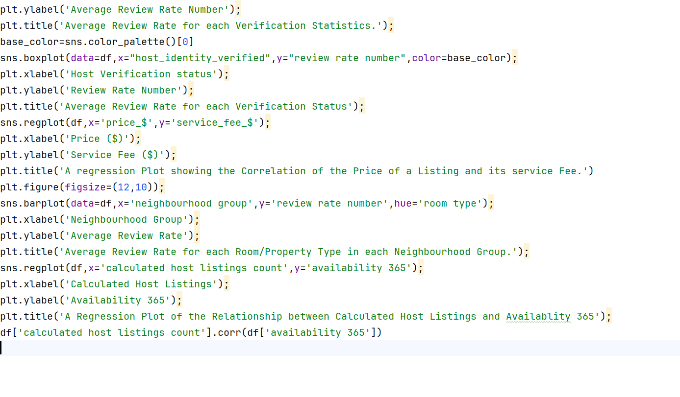
RESULTS1
Demo Link

Slide 8
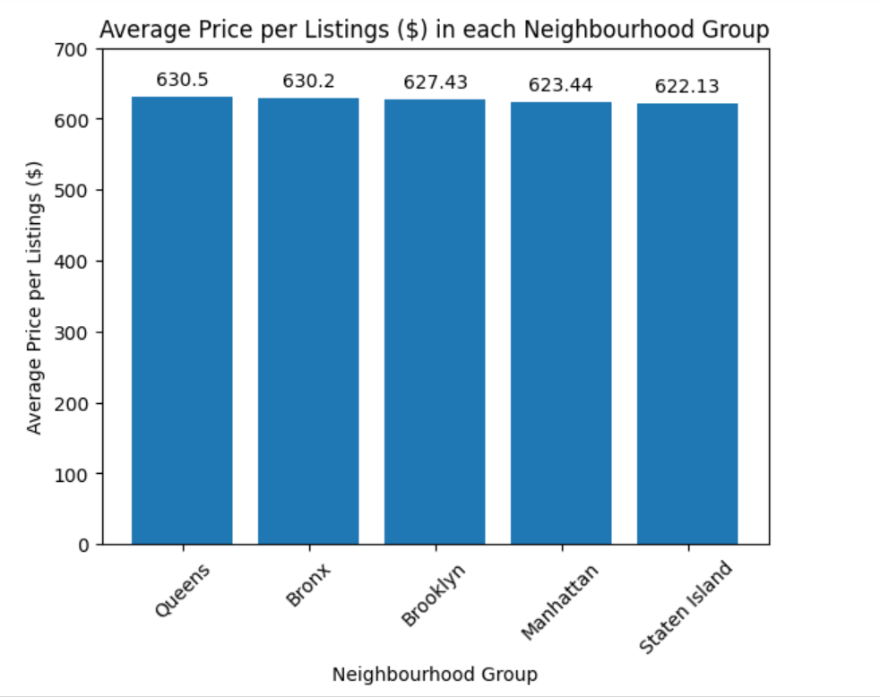
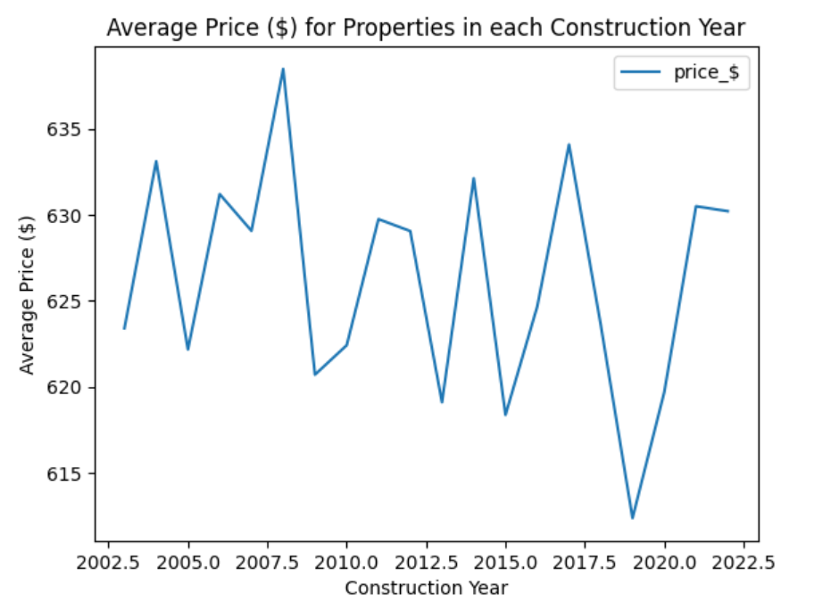
RESULTS2
Demo Link

Slide 9
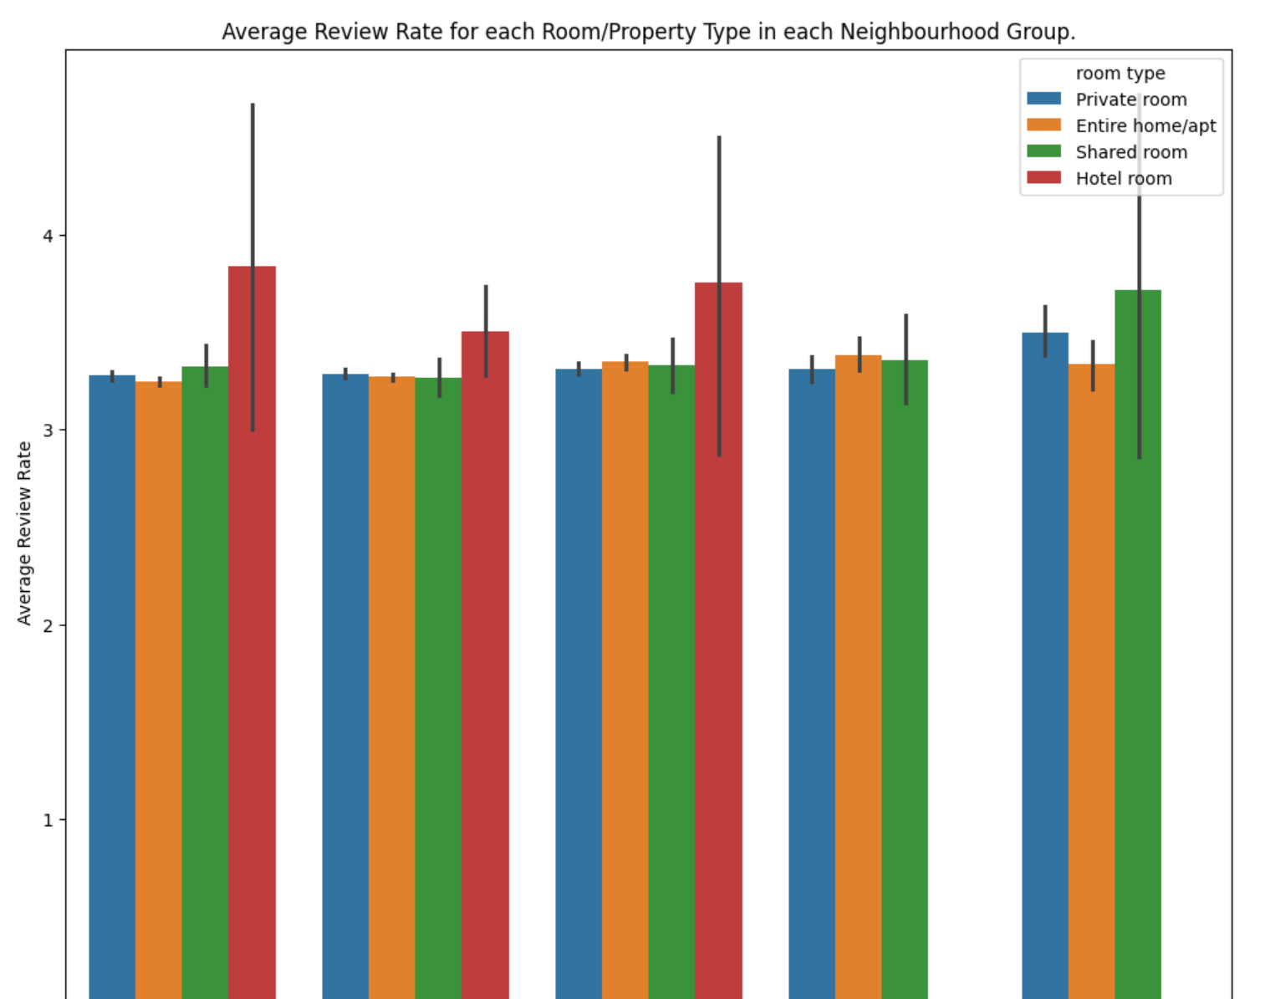
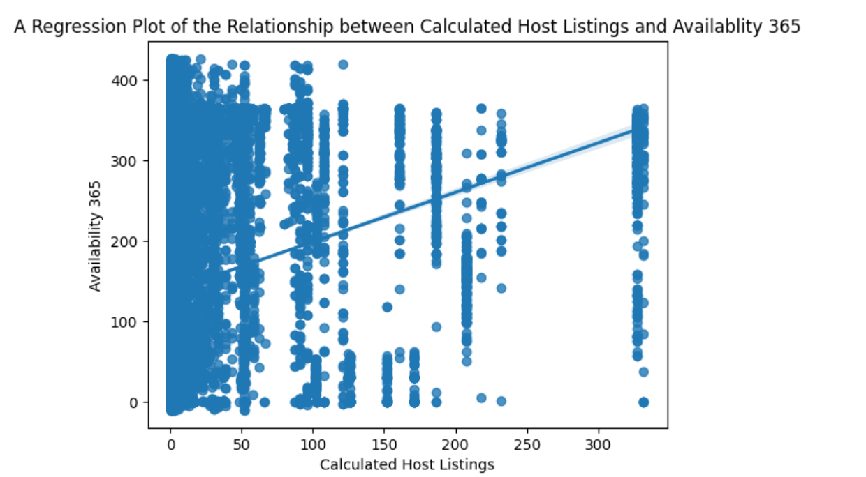
RESULTS3
Demo Link

Slide 10
GitHub repository
https://github.com/Akshita21-09/VOIS_AICTE_Oct2025_Akshita-R.git
Demo Link

Slide 11
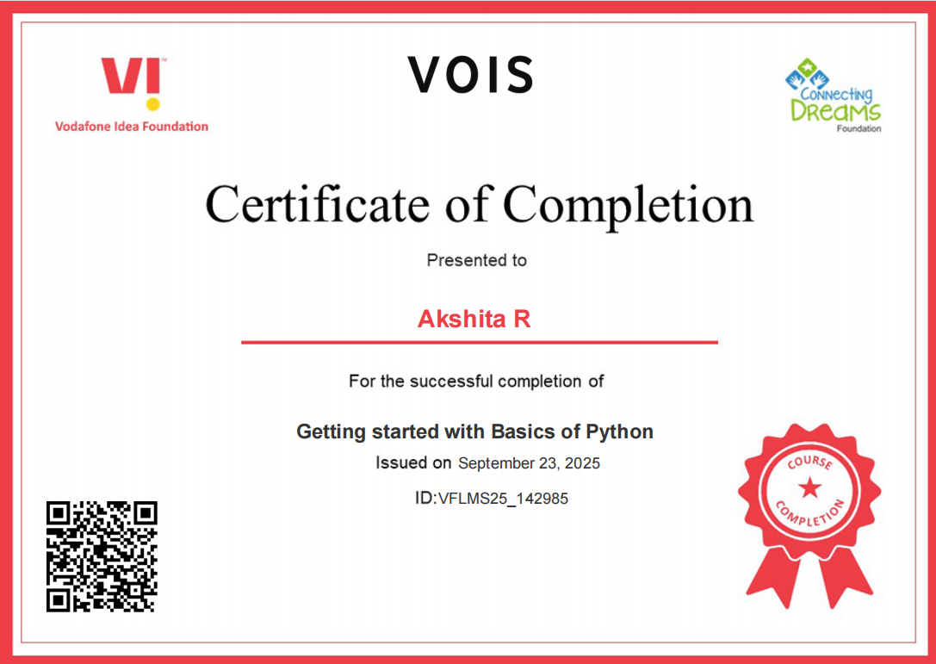
Getting started with Basics of Python Certificate

Slide 12
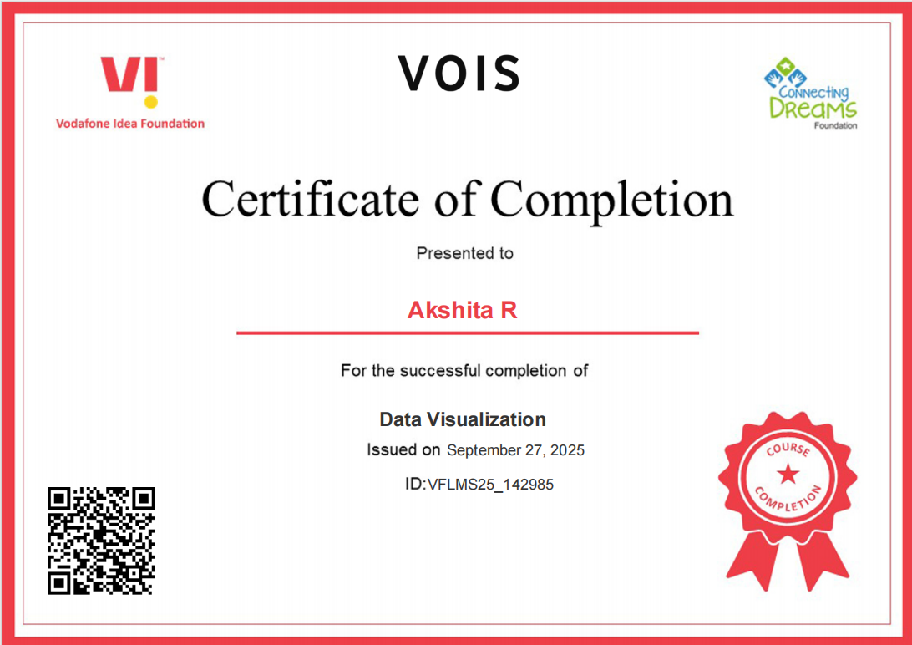
Data Visualization Certificate

Slide 13
Thank you
.
.

